Slide 1
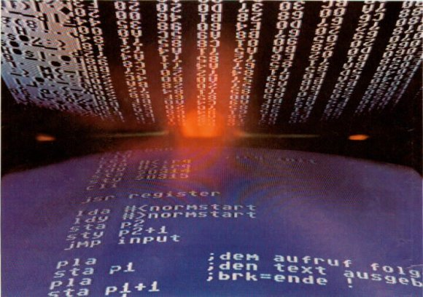
Programming Concepts

Slide 2
What is programming?
Programming is a creation of a set of commands or instructions which directs a computer in carrying out a task.
OR
“The process of writing programs” is called programming.
Programming languages are used to write programs
Program must be written in a way the computer can understand

Slide 3
PROGRAMMING PROCESS `
Source Code
Compiler
Machine Understandable code
Execution
Result generation

Slide 4
What is a Program?
A computer program is a series of organized instructions that directs a computer to perform tasks.
Without programs, computers are useless.
A program can be written in a programming languages, such as C, C++ or Java.

Slide 5
What is a Programming Languages?
A programming language is a set of rules that provides a way of telling a computer what operations to perform.
A programming language is a set of words, symbols and codes that enables humans to communicate with computers.
Series of instructions to a computer to accomplish a task.
A programming language is a notational system for describing computation in a machine-readable and human-readable form.

Slide 6
What is a Programming Language…..
English is a natural language. It has words, symbols and grammatical rules.
A programming language also has words, symbols and rules of grammar.
The grammatical rules are called syntax.
Each programming language has a different set of syntax rules.

Slide 7
Generation of Programming Languages
First Generation Languages
Second Generation Languages
Third Generation Languages
Fourth Generation Languages
Fifth Generation Languages

Slide 8
FIRST GENERATION OF PROGRAMMING LANGUAGE
The first generation of programming language, or 1GL, is machine language.
Machine language is a set of instructions and data that a computer's central processing unit can execute directly.
Machine language statements are written in binary code, and each statement corresponds to one machine action.

Slide 9
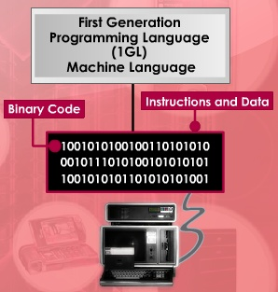

Slide 10
SECOND GENERATION PROGRAMMING LANGUAGE
The second generation programming language, or 2GL, is assembly language.
Assembly language is the human-readable notation for the machine language used to control specific computer operations.
An assembly language programmer writes instructions using symbolic instruction codes that are meaningful abbreviations or mnemonics.
An assembler is a program that translates assembly language into machine language.
Since assembly language consist of human-readable abbreviations, the assembler must first convert assembly language into machine-readable language before the computer can readily understand its instructions.

Slide 11
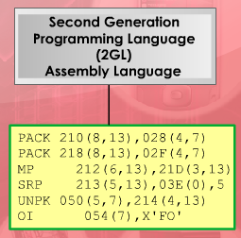
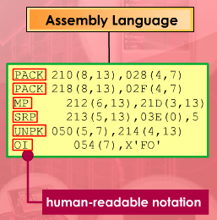
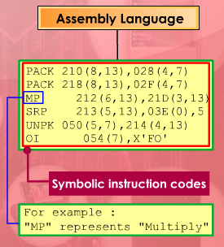

Slide 12
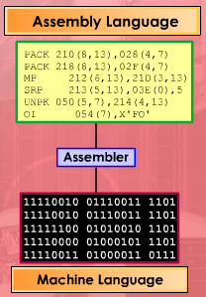

Slide 13
THIRD GENERATION PROGRAMMING LANGUAGE
The third generation of programming language 3GL is a High-level programming languages , or procedural language uses a series of English-like words, that are closer to human language to write instructions.
High-level programming languages make complex programming simpler and easier to read, write and maintain.
Programs written in a high-level programming language must be translated into machine language by a compiler or interpreter.
PASCAL, FORTRAN, BASIC, COBOL, C and C++ are examples of third generation programming languages.

Slide 14
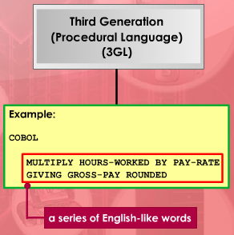
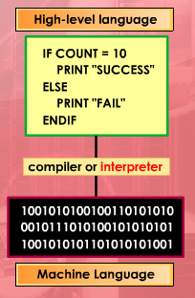
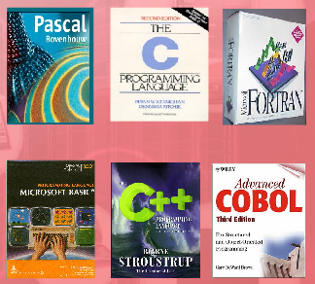

Slide 15
FOURTH GENERATION PROGRAMMING LANGUAGE
The fourth generation programming language or non-procedural language, often abbreviated as 4GL, enables users to access data in a database.
A very high-level programming language is often referred to as goal-oriented programming language because it is usually limited to a very specific application and it might use syntax that is never used in other programming languages.
SQL,and FOCUS are examples of fourth generation programming languages.

Slide 16
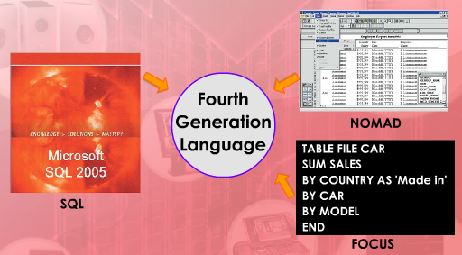
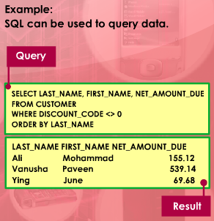

Slide 17
FIFTH GENERATION PROGRAMMING LANGUAGE
The fifth generation programming language or visual programming language, is also known as natural language
A computer language that includes the most advanced concepts in computer programming and programming languages in use today.
concepts such as those used in expert systems, knowledge-based systems, inference engines, natural language processing, and virtual reality
Provides a visual or graphical interface, called a visual programming environment, for creating source codes.
Prolog and Mercury are the best known fifth-generation languages.

Slide 18
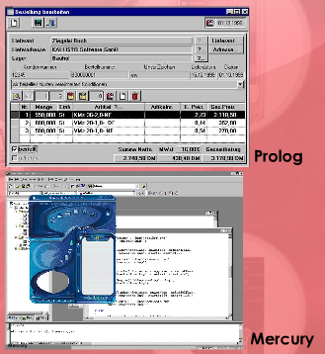

Slide 19
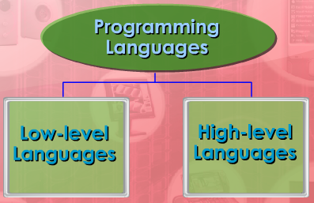
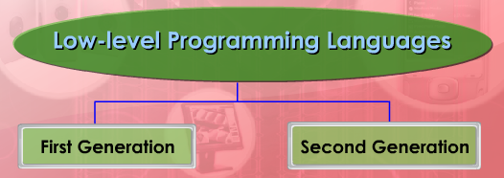
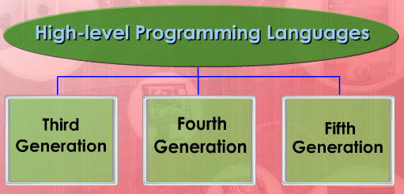
Levels of Programming Language

Slide 20
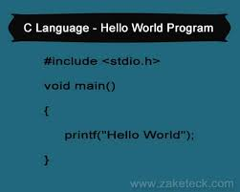
Levels of Programming Languages
High Level Languages
The high-level languages
are much closer to human language.
Codes similar to everyday English
They are easier to read , write and
maintain.
They are designed to run on a number of different computers.
A programming language such as C, FORTRAN or Pascal that enables to
write programs which is understandable to programmer (Human) and can perform
any sort of task.
Such languages are considered high-level because they are closer to human languages.

Slide 21
Low Level Language
Low Level Language are closer to machine language.
These are understood only by the Microprocessor
Low level language is a language that supports the machine side of the programming or does not provide human side of the programming
Assembly language & machine language are type of low level languages.

Slide 22
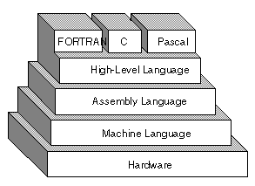
Architecture

Slide 23
Translation method of programming using :
i) Translator
ii) Interpreter,
iii) Compiler
iv) Assembler,

Slide 24
TRANSLATOR
Sometimes two people cannot understand each other because they don’t speak the same language. So they need the help of a third person who understands both languages. This third person is known as a translator.
All software packages or programs are written in high-level languages, for example, C++, Visual Basic and Java.
However, in order for the computer to be able to carry out the instructions, the high-level languages must be translated into machine language before the computer can understand and execute the instructions in the program.
The translation of high level languages to machine language is performed by a translator.

Slide 25
Interpreter
An interpreter is a program that executes programming code directly.
Interpreter can convert a source code , usually on a
step-by-step, line-by-line and unit-by-unit basis into machine code.
Interpreted languages are read and then executed directly, with no compilation stage.

Slide 26
Compiler
A compiler is a special program that processes statements written in a particular programming language and turns them into machine language or "code" that a computer's processor uses.
The compiler derives its name from the way it works, looking at the entire piece of source code and collecting and reorganizing the instructions.
Thus, a compiler differs from an interpreter, which analyzes and executes each line of source code in succession, without looking at the entire program.
However, programs produced by compilers run much faster than the same programs executed by an interpreter.

Slide 27
Interpreter | Difference | Compiler
Translate programming statement line by line and execute it immediately. | Method | Translate entire programming statement and execute it later.
No object code is saved. | Object code | Store machine language as object code on the disk.
Interpreted code run slower. | Running time | Compiled code run faster.

Slide 28
Assembler
Assembler normally converts assembly language’s source code into machine language.
Assembly language is a family of low-level languages for programming computers. It implements a symbolic representation of code.
An assembler is a program that takes basic computer instructions and converts them into a pattern of
bits ( 0 & 1) that the computer runs to produce result.

Slide 29
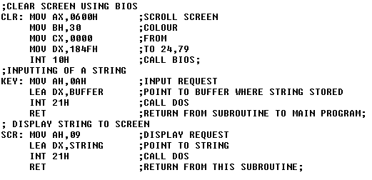
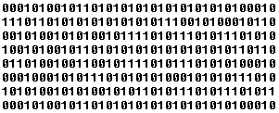
Assembly
code
Assembler
Object code

Slide 30
Why Are There So Many Programming Languages?
Different programming languages are designed for different types of programs.
First programming languages were developed in the 1950s
Since then thousands of languages have been developed

Slide 31
Types of Programming Languages
FORTRAN
FORmula TRANslation.
Developed at IBM in the mid-1950s.
Designed for scientific and mathematical applications by scientists and engineers.

Slide 32
Programming Languages……
COBOL
Common Business Oriented Language.
Developed in 1959.
Designed to be common to many different computers.
Typically used for business applications.
BASIC
Beginner’s All-purpose Symbolic Instruction Code.
Developed in mid 1960s.
Developed as a simple language for students to write programs with which they could interact through terminals.

Slide 33
Programming Languages……
C
Developed by Bell Laboratories in the early 1970s.
C has proved to be a powerful and flexible language that can be used for a variety of applications, from business programs to engineering.
Often used for system programs.
UNIX is written in C.
C++
It is C language with additional features
Developed in 1983.
Widely used for developing system and application software.
Graphical user interfaces can be developed easily with visual programming tools.

Slide 34
Programming Languages……
JAVA
An object-oriented language similar to C++
Developed in 1990.
Java almost used in every field like making Websites, Software’s, applications and more.
Java is fast, secure, and reliable programming language

Slide 35
Programming Languages……
PROLOG- Programming Logic
Prolog is a high-level programming language based on formal logic.
Developed in 1975.
Unlike traditional programming languages that are based on performing sequences of commands,
Prolog is sometimes called a declarative language or a rule-based language because its programs consist of a list of facts and rules.
Prolog is used widely for artificial intelligence applications, particularly expert systems.

Slide 36
Procedural Languages
Early high-level languages are typically called procedural languages.
Procedural languages are characterized by sequential sets of linear commands. The focus of such languages is on structure.
In the early days programs were usually run as batch jobs and required very little user interaction – so they were basically a series of instructions to be carried out in a specific sequence.
Examples include C, COBOL, Fortran, LISP,

Slide 37
OBJECT-ORIENTED PROGRAMMING
Most object-oriented languages are high-level languages.
The focus of OOP languages is not on structure, but on modeling data.
The object-oriented approach refers to a special type of programming approach that combines data with functions to create objects.
Examples of OOP languages include C++, Visual Basic.NET and Java.

Slide 38
Web Scripting Languages
The explosion of the Internet and more especially the World Wide Web in the 1990s created a demand for new technologies.
All web pages are written in HTML (hypertext mark-up language).
This is not really a language at all, just a set of tags that can be used to control the display of fonts.
Early web pages were static, so new scripting languages (e.g. JavaScript, VBScript ) emerged to provide dynamic content.
Mostly interpreted, either client-side or server side.

Slide 39


